Slide 1






Addis Ababa Institute of Technology
Center of Information Technology and Scientific Computing
Department of Software Engineering AUGMENTED REALITY SYSTEMS
Team Members
Elbetel Gezahegn ATR/3445/08
Kimiya Mohammed ATR/2765/08
Lulit Mulugeta ATR/3806/08
Rahel Getachew ATR/0621/08
Yeabsira Gashaw ATR/6749/08
Yonas Alem ATR/1017/08
Submitted to: Instructor Aberham
DATE: 24/05/2018

Slide 2
INTRODUCTION
Augmented reality (AR) is an intriguing user interface technique that combines the properties of the real world with information processed by a computer. By augmenting the experience of the real world with computer generated sensations, e.g. through the use of head mounted displays with optical combiners, virtual information can behave like a real object and users can leverage their knowledge of the real world to interact with that information. The ambitious goal of AR is to create the sensation that virtual objects are present in the real world.
The goal of Augmented Reality (AR) is to improve and enhance our perception of the surroundings by combining sensing, computing and display technologies. Most AR research addresses human vision, as it is generally considered to be our most important sense. Visual systems are also the focus in this overview, but it is worth noting that other stimuli, such as feedback from auditory, tactile or olfactory displays, may be equally or even more important, depending on the specific scenario and individual.
The characteristics of these systems can be further understood from three classical and widely used criteria for AR systems [Azuma 1997]:
“Combines virtual and real”
AR requires display technology that allows the user to simultaneously see virtual and real information in a combined view. Traditional displays can show only computer-generated images and are thus insufficient for AR.
“Registered in 3-D”
AR relies on an intimate coupling between the virtual and the real that is based on their geometrical relationship. This makes it possible to render the virtual content with the right placement and 3D perspective with respect to the real.
“Interactive in real time”
The AR system must run at interactive frame rates, such that it can superimpose information in real-time and allow user interaction.

Slide 3
The fundamental idea of AR is to combine, or mix, the view of the real environment with additional, virtual content that is presented through computer graphics. Its convincing effect is achieved by ensuring that the virtual content is aligned and registered with the real objects. As a person moves in an environment and their perspective view of real objects changes, the virtual content should also be presented from the same perspective.
The Reality-Virtuality Continuum [Milgram and Kishino 1994] spans the space between reality, where everything is physical, and virtual reality, where virtual and synthesized computer graphics replace the physical surroundings. Mixed reality is located between them, and includes AR and augmented virtuality.
AR adds virtual content to a predominantly real environment, whereas augmented virtuality adds real content to a predominantly virtual environment. Although both AR and augmented virtuality are subsets of mixed reality by definition, most of the research in the area focuses on AR, and this term is therefore often used interchangeably with mixed reality.
AR techniques exploit the spatial relationships between the user, the digital information, and the real environment, to enable intuitive and interactive presentations of data. An AR system can, for example, achieve medical see- through vision, by using a special display in which the images displayed by the computer are seen overlaid on the patient [State et al. 1996, Stetten et al.2001].
Such configurations rely on the proper acquisition and registration of internal medical imagery for the relevant perspective, and careful calibration to establish the geometrical relationship between the display, the viewer, and the patient, to ensure that the correct image is accurately presented.
PROBLEM STATEMENT
All the typical software components in augmented reality systems have been subject to extensive research during the last few years. The work has resulted in a number of frameworks that encapsulate algorithms and implementation expertise in various specialized problems in code, ready for the developer to reuse. However, these frameworks typically provide the developer with a

Slide 4
set of library calls or objects that implement the specific algorithms but without illuminating the overall application design. The fine-grained functionality provided by an application programming interface usually requires a large management overhead on the part of the application programmer and therefore still allows inefficient implementations.
The level of abstraction within the frameworks is not sufficiently high to support the exploratory and iterative development process that would be ideal for AR applications. A large number of existing frameworks are based on languages that require compilation and therefore already oppose frequent changes. Others employ interpreted languages but the disadvantages of too fine-grained APIs persist.
Additionally, some software frameworks provide high-level architectural patterns such as means of inter-component communications that are too general to direct the developer towards a working design. The problem is that the trade-offs associated with applying the general architecture to the application is often non-obvious. For example, a generic inter-component communication facility allows the implementation of every single software object as a full-fledged component at the cost of increased communication overhead. Aggregating the functionality into appropriate components to improve performance while retaining modularity is usually non-trivial.
PROPOSED SOLUTION
Nowadays AR is one of the most important worldwide trends. It is growing fast and still long way to go. Because of its amazing features, it is getting a lot of attention from the world. And people from different fields are using it. Some of the areas which AR is implemented are discussed as follow: -
Teaching and Training
Augmented reality seems like a natural fit for teaching in the classroom or the workplace. The ability to slip on a headset like the Google Glass and have a live tutorial play before your eyes as you perform a task for the first time sounds like the perfect solution for learner and teacher alike. Unlike the real-world training scenarios, a trainer or tutor can leverage augmented reality to make learning new concepts and processes easier for trainees and

Slide 5
students. For instance, taking a virtual car engine apart through AR is far easier than a real one. Moreover, the process can be repeated as many times as required. With the help of an augmented reality app, an enterprise can not only educate individuals but also help them hone their skills and capabilities.
Marketing
One obstacle to online shopping is that products are not always correctly represented, oftentimes due to poor photo availability. With augmented reality, it is possible to visualize an object in its "true" form before actually making a purchase. Alternatively, in situations where users may find themselves without the proper assistance or information in real time, augmented reality adds value to the procurement process. On a commercial site, it can create interactions that would not have existed between a customer and a vendor.
Tourism
Augmented reality can be used in the field of tourism to enhance user experience during visits. In Bordeaux, for example, it is possible to view the current monuments in the context of the eighteenth century by simply downloading an application on a tablet.
The Eiffel Tower also has its own augmented reality application for viewing its construction.
Business
There are multiple uses for augmented reality in business content. In some physical stores, augmented reality allows users to try on clothes without going to the fitting room. Some stores even use augmented reality to attract customers to a store via mobile application. In Paris, a grocery store recently invited customers to their shop by inviting Pokémon GO players to capture and battle Pokémon in store.
Manufacturing
AR can facilitate and accelerate the building processes at the factory. Project managers can monitor work progress in real time through AR markers on

Slide 6
equipment. Besides, it can save a ton of time by using digital maps and plants. Pointing a device into location shows how the piece of a machine will fit the final construction.
Object Visualization:
Another application of AR is the way it helps to place digital assets in the physical world. Merging the virtual objects with the real world allows developers to interact with the digital elements (3D objects) they created as if they were real objects. For example, car designers have to work on thousands of parts to get the car design right. Using immersive AR technology and computer graphics, they can project the virtual layouts of a car’s interior on a full-size model of a car dashboard. Visualizing digital objects through AR in such a manner provides detailed insights into what a finished product would look like as compared to a flat product image on the screen.
Sports
We’ve all been there when a referee’s wrong decision has cost our team that pivotal goal or try. Imagine we could avoid that heartbreak, those sorrowful pints in the pub afterwards. Well, the future is now. Referees could use augmented reality to verify and corroborate their decisions with other experts on the fly to ensure their verdicts were as accurate as possible, but most importantly, the impact on the flow of the game or event would be kept to a minimum improving the viewers’ experience.
Audiences could also use AR at sporting events for additional information and interactivity using things like dedicated companion apps.
ADVANTAGES
Anyone can use it.
Blurred strict line between the real world and virtual world.
Reality with more information added to it that is in normal terms not available.
More interactive abilities while using computers, mobile phones and other digital devices. Information about the surrounding world becomes interacted and digitally manipulated.

Slide 7
DISADVANTAGES
Threats to privacy and issues of the privacy control. Walking up to a stranger or a group of people with AR device might reveal status, Tweets, and other personal information that may cause breache of privacy.
Openness: Other people can develop their own layers of content to display. That could cause information overload and augmenting without permission.
Interoperability : The lack of data portability between AR environments (such as Wikitude AR and Layar AR browser) Regarding user experience, socially using Augmented Reality may be inappropriate in some situations.
Spam as it is easy to imagine that spam could overwhelm the augmented world with unwanted advertising or unwanted information of any kind.
Content may obscure and/or narrow a user’s interests or tastes. For example, people may want off-the-beaten-track places and not KFCs or McDonalds.
Price – as the technology is still developing it may be quiet expensive to use it in everyday life and it might be less accessible for small businesses.
There are a number of constraints that limit what can be done with mobile AR applications and/or additional things that the application developer must address to overcome those constraints. The constraints are generally related to the limited capabilities of mobile devices, and that the application must be workable in a very wide variety of environmental conditions.
IMPLEMENTATIONS
There are different kinds of devices used for presentation but they have common paradigms.
The First key problem is the identification of the object before the users because there different kinds of implementation used for different devices based on their platforms.

Slide 8
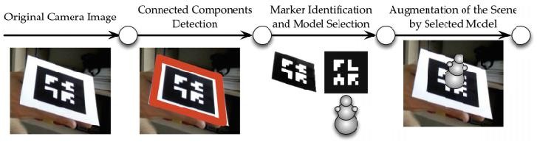
Object Detection Method
The general structure of of any application based on image processing. We acquire image from camera and store into inner presentation (kind of RGB mix) and identify the possible wanted object based on position and orientation.
After we select our basic platform for the implementation then the next step to select the libraries and tools for the software implementation.
Steps for Implementation of AR Requirement Analysis
Real world interfacing
One aspect that makes AR different from other media application is the presence of real world in user’s perception of the application spaces.so we have to take into account of real world when we structuring the application space and interaction.
We have to render the real world into AR object as the stages in theatre.
hardware Abstraction
There are different hardware devices, setups and interaction techniques in
which the AR are applied that means “written once run everywhere”.
They used vitalization process that means they are develop in some workstation instead of developing the system for the target devices.

Slide 9
This gives us importance other development as an input such as virtual reality.
In General they should use common paradigms and algorithms to develop then apply them based on some different making on the type of devices but the core modules should be the same.
3) Run time Engine
The Authoring or the hardware abstraction cannot seen isolation from the run time engine that manages all aspects of the AR such as space and time as well coordinating mechanisms based on the run time engine as a core.
->Authoring Work flow
Authoring or developing the source of AR is more than providing the proper user Interfaces on the top of Run time Engine.
There should be separation of Concerns allows of developing different libraries and mixing them as once and this gives as freedom to use them as separate they will serve as input for the field of works.
There are different Kinds of Authoring
3D Modeling and scripting
It’s one of most important of authoring modeling the 3D word into 2D
space, we use matrix for the coordinates and the object dimension
Application Specific Authoring
If we provides the general paradigms and authoring for the whole devices there will be device and application specific authoring that will maintain the device compatibility issues and development for special purpose such as military mission or space crafts.
General Purpose development

Slide 10
This part targets all devices that use the AR technology.
The APRIL (Augmented Reality Presentation and Interaction Language) language
-> covers all aspects of AR developments in the stages of AR development April provides elements to describe the hardware setup, including displays and tracking devices as well as the content of application and its temporal organization and interactive capabilities.
Its XML based language for expressing all information about setups and the
media description its basically the same like android it have XML and glue code between the presentation and programming parts.
The main aspect that contributes the application is encapsulated into four top level elements cast, story, behavior and interactions.
=>Story - the explicit presentation of temporal structure of the application which composed of the individual scenes.
=>in each scenes the predefined sequences of behaviors are presented which are reusable components which the input and outputs.
=>Interaction - the transition between the one story of scene to another is provided by interaction.
=>casts are mapping the real world into digitized environments.
After that there is hardware setup that provides a layer of abstraction that hides details of the underlying hardware setup from the user.

Slide 11
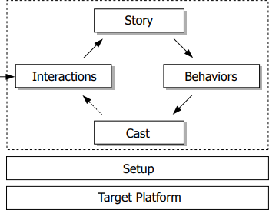
Figure 2.The Main components of APRIL.
The are Two Fundamental Organization Related with AR
Temporal organization
->determining the visibility and behavior of objects over time.
Spatial Organization
->determining the location and size of object relative to the users. Hardware Abstraction using APRIL
This allows the hardware description in different files.
This is used for mapping the application level program to hardware-level features.
It describes the host elements for each devices, display information, pointer

Slide 12
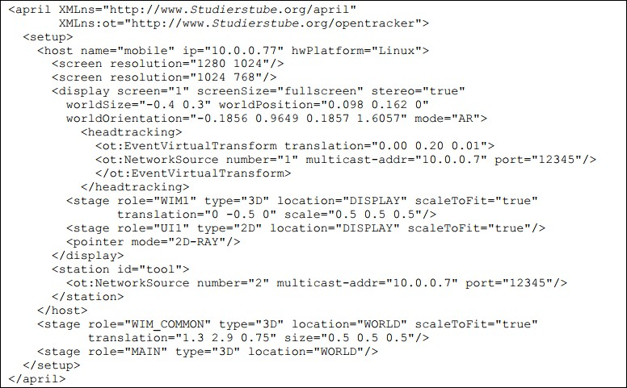
Figure 3, APRIL for the hardware setup
Model component and Geometry
So the components should be organized from the reusable components,they should be defined in separate in outside from the application,to allow re- usability and setups.
A component can have multiple implementations in different host languages
– the software
Used for playing the APRIL application will choose the most suitable implementation.

Slide 13
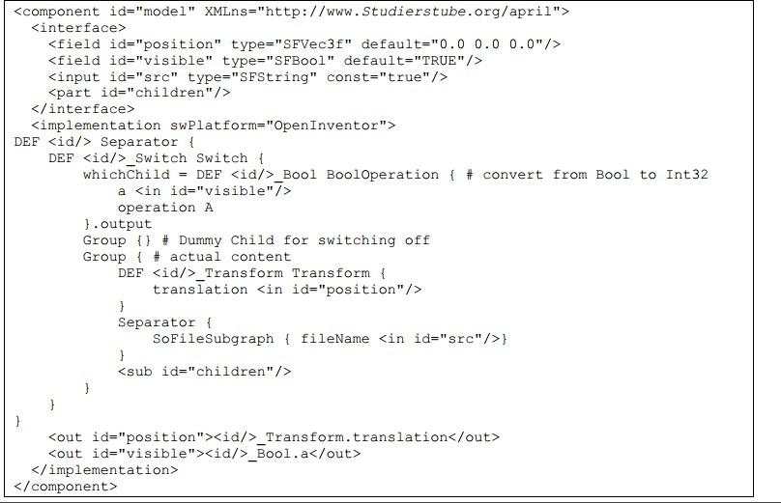
Figure 4, Component Model in APRIL
Application Control and interaction
->after we set the component model and hardware abstraction then we should have the control and interaction mechanism
The are two basic commands to change the values in the field set and animate.
There is button action to interact and there should be timeout all are specified.
Model and transformations in APRIL
->there different processes appear before the display of AR Images processing ->3D rendering ->2D mapping e->editing...

Slide 14
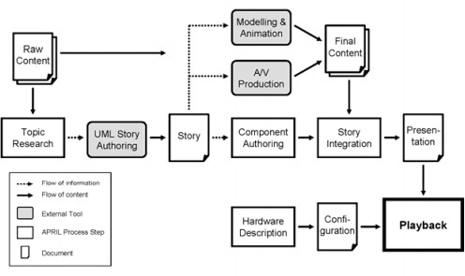
Schematic transformation of ARPIL processing

